Slide 1
Endocrinology and metabolism
Direction of study
Hypothalamic-pituitary regulation system.

Slide 2
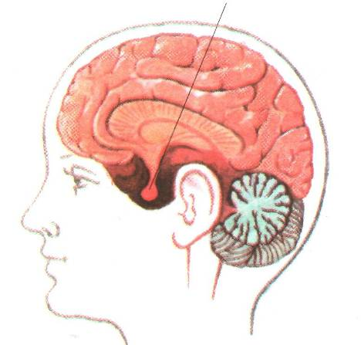
Pituitary
The pituitary gland - the lower cerebral appendage, located at the base of the brain above the midbrain in the bone notch - the Turkish saddle

Slide 3
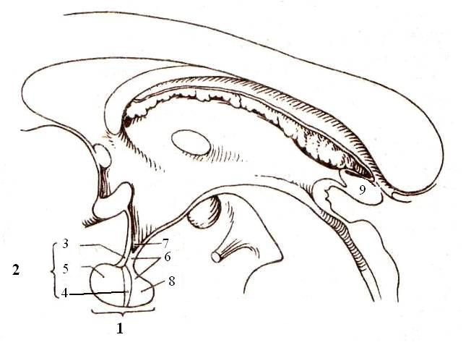
The structure of the pituitary gland
1 - pituitary gland
2 - anterior lobe (adenohypophysis)
3 - tuberous part
4 - intermediate part
5 - distal part
6 - posterior lobe (neurohypophysis)
7 - funnel
8 - nerve lobe
9 - pineal gland

Slide 4
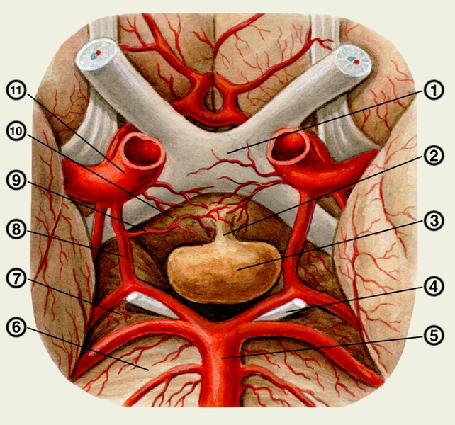

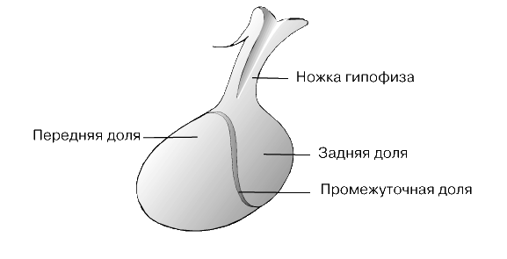
Anatomy
Pituitary
The pituitary gland is located at the base of the skull, in the groove of the ethmoid bone called the Turkish saddle.
The pituitary gland consists of two lobes - a larger anterior lobe and a smaller posterior lobe.
(+ intermediate)

Slide 5
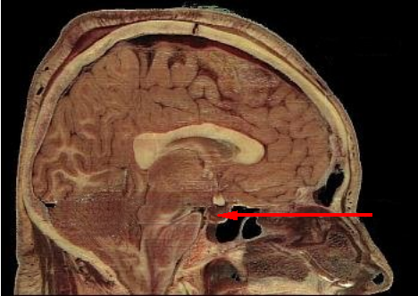
The size of the pituitary gland
The mass of the pituitary gland in men is about 0.5 g, in women - 0.6 g, and in pregnant women it can increase to 1 g. The transverse size of the pituitary gland is 10-17 mm, anteroposterior - 3-8 mm, vertical - 5-10 mm. Outside, the pituitary gland is covered with a capsule.

Slide 6
Pituitary hormones
Anterior lobe
intermediate part
posterior lobe
Intermedin
(melanocyte-stimulating)
Vasopressin (ADH)
Oxytocin
Growth hormone (STH);
Regulatory:
ACTH (adrenocorticotropic)
TSH (thyriotropic)
FSH (follicle stimulating)
LH (luteinizing)
LTG (lactagenic)

Slide 7
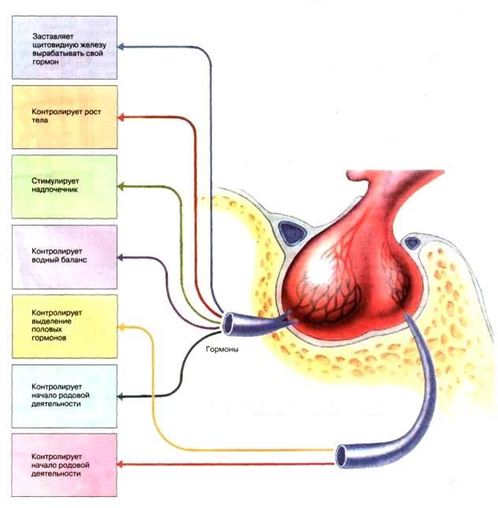
Pituitary functions

Slide 8
Anterior pituitary hormones
Hormones | Function under normal conditions | Increased function | Reduced function
Growth hormone | Ensuring growth organism in a young age | In young age causes gigantism, in adults - overgrowth, enlargement of body parts - acromegaly | Retains growth - dwarfism; body proportions and mental development - normal
ACTH TSH FSH LH LTG | Regulate activity adrenal cortex, Thyroid gland, gonads, genitals, lactation | Strengthening activities listed glands | Weakening of activity listed glands

Slide 9
Hormones of the posterior and middle lobe of the pituitary gland
Hormones posterior lobe | Function under normal conditions | Increased function | Reduced function
Vasopressin (ADH) Oxytocin | Regulates musculature and blood vessels uterus. Water reabsorption in the kidney | Decrease fluid excretion with urine | Magnification fluid excretion with urine
intermediate part | Function under normal conditions | Increased function | Reduced function
Intermedin | Distribution pigment in the skin | Increased pigmentation | Reduction of pigmentation

Slide 10
Hypothalamic hormones
Hormones | Function under normal conditions | Increased function | Reduced function
Liberins | Stimulate hormone production anterior pituitary gland | Hyperfunction anterior pituitary gland | Hypofunction anterior pituitary gland
Statins | Brake hormone production anterior lobe pituitary gland | Hypofunction anterior pituitary gland | Hyperfunction anterior pituitary gland

Slide 11
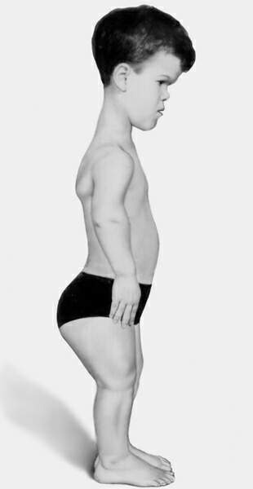
Pituitary gland pathologies
The pituitary gland can be characterized by hyperfunction and hypofunction, which leads to the occurrence of endocrine diseases. So, as a result of increased secretion, a person may develop gigantism or acromegaly, Itsenko-Cushing's disease. Reduced production of biologically active substances causes hypothalamic-pituitary insufficiency
\

Slide 12
Thank you for your attention

